Slide 1
Library Management System
PRESENTED BY:
AREEBA FATIMA
HAFSA SHAHID
RIDA SAJID

Slide 2
INTRODUCTION
Purpose: Automate library operations for faster and error-free management.
Problem: Manual tracking of books, members, and fines is time-consuming.
Solution: A digital system to manage books, members, issue/return records, and fines efficiently.
Project Objective: To develop a system that efficiently manages library books, members, and transactions with minimal manual effort.
Key Features:
Add/View Members & Books
Issue/Return Books
Track issued books and fines
Technology Used:
C++,if else, switch, loops, Structures, Arrays, pointers, Function.

Slide 3
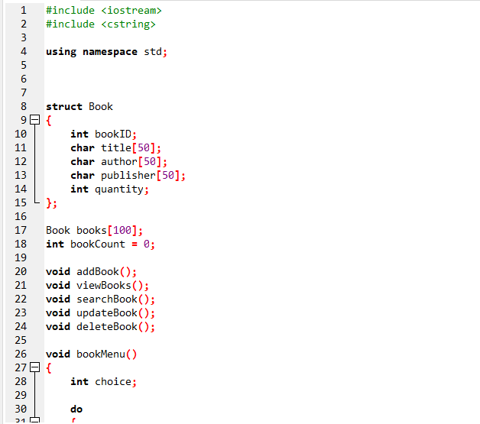
CODE

Slide 4
Book Management Module
First, we have the Book Management Module.
This part is all about managing the library’s books.
With this module, you can:
  Add a Book – Add new books with details like ID, title, author, publisher, and quantity.
  View Books – See all the books that are currently in the library.
  Search a Book – Look for a book by its ID.
  Update Book Details – Change any information if needed.
  Delete a Book – Remove a book that’s no longer available.
Here, I used a structure called Book to keep all the details together and an array to store multiple books. The menu keeps looping so the librarian can keep adding or managing books easily.

Slide 5
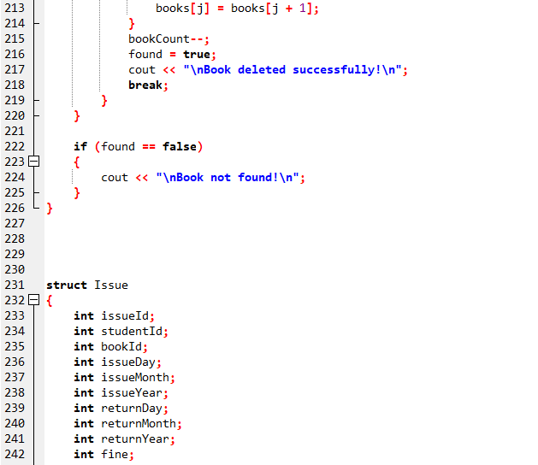

Slide 6
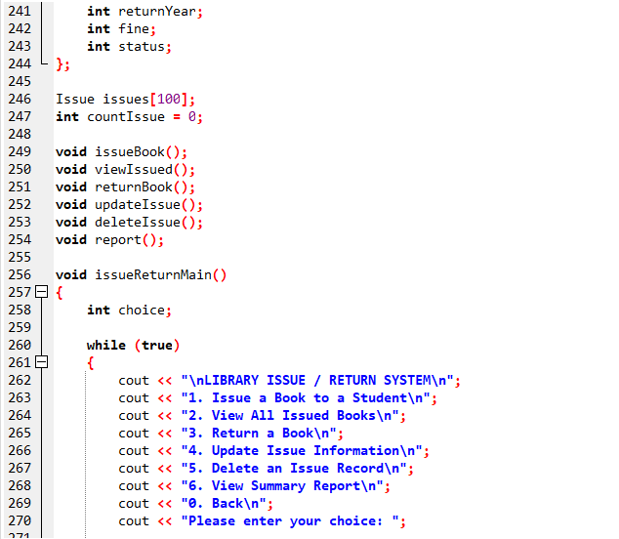

Slide 7
Issue/Return Module
We have the Issue/Return Module, which handles the borrowing and returning of books.
Here, you can :
  Issue a Book – Assign a book to a student and record the issue date.
  View Issued Books – See which books are currently borrowed.
  Return a Book – Record the return date and automatically calculate fines if a book is late.
  Update Issue Records – Change issue information if needed.
  Delete Issue Records – Remove old records.
  View a Summary Report – Check total books issued, returned, pending, and total fines collected.
I used a structure called Issue to keep all the details about each book issue. The system even calculates fines if a book is returned late, making it more realistic for library management.

Slide 8
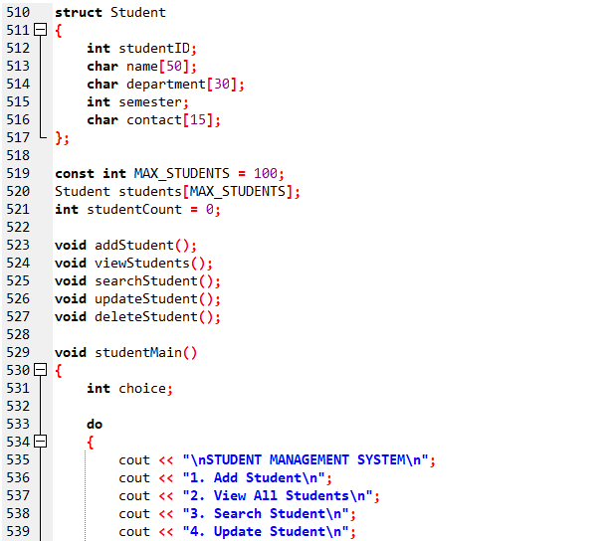

Slide 9
Student Management Module
Next is the Student Management Module.
This part is for keeping track of students who use the library.
Here, you can:
  Add a Student – Store student ID, name, department, semester, and contact.
  View Students – Display all students.
  Search Student – Find a student by their ID.
  Update Student Info – Edit any student details.
  Delete Student – Remove students who are no longer using the library.
I used a structure called Student and an array to save all student data. The menu works the same way as in the Book Module, so it’s very user-friendly.

Slide 10
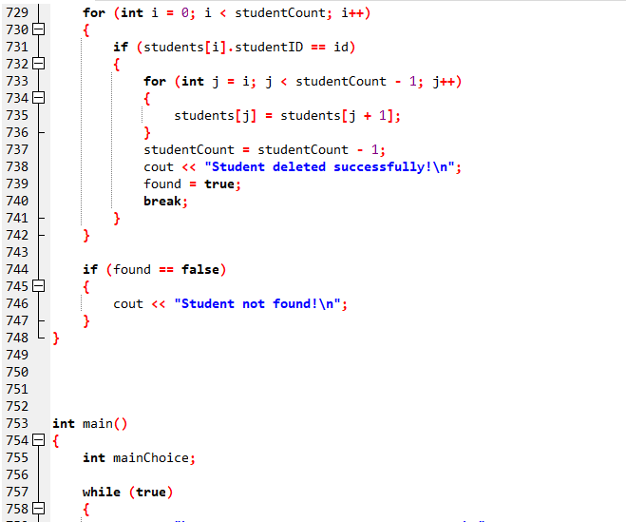

Slide 11
Main Menu and Key Points
All three modules are connected through a Master Menu in the main() function:
Book Management Module
Issue/Return Module
Student Management Module
Exit System
So the user can easily choose which part to use without restarting the program.
KEY POINTS WE USE
• Structures – To organize book, student, and issue data.
• Arrays – To store multiple records.
• Functions – Each task has its own function to make the program clean and organized.
• Loops and Menus – To keep the program interactive.
• Conditional Statements – To handle user choices and errors.
• Simple Date Calculations – For calculating fines when books are returned late.

Slide 12
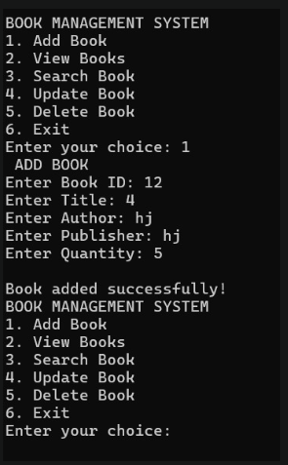
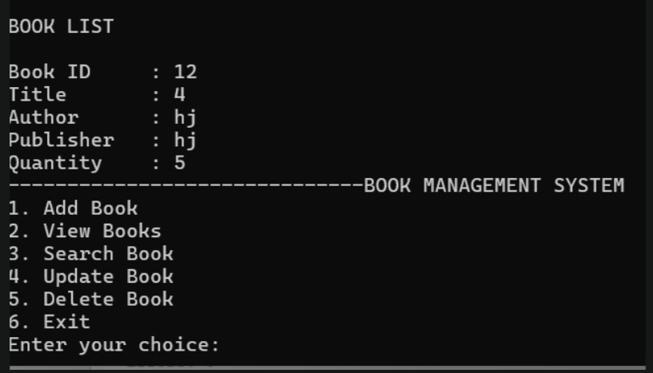
OUTPUT
OUTPUT-01
OUTPUT-02

Slide 13
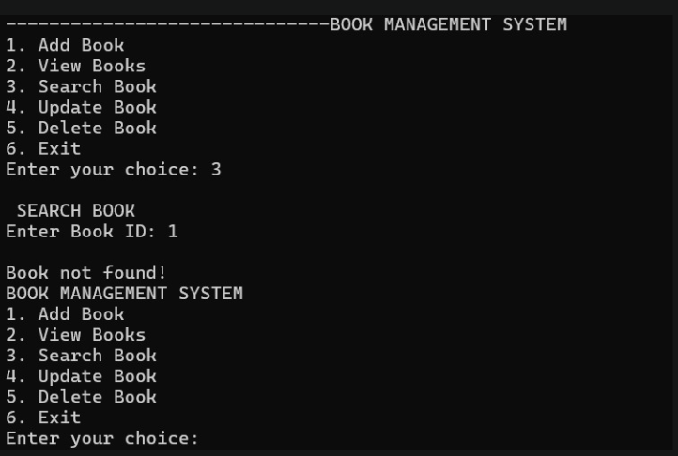
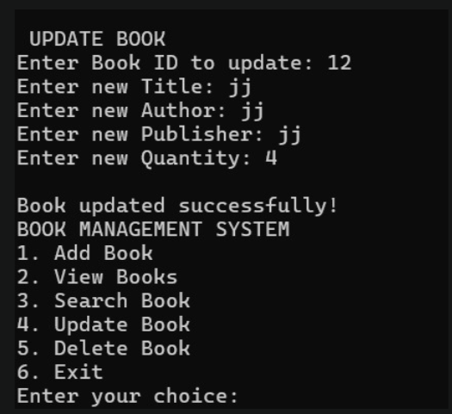
OUTPUT-03
OUTPUT-04

Slide 14
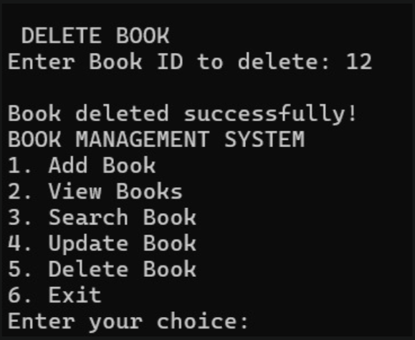
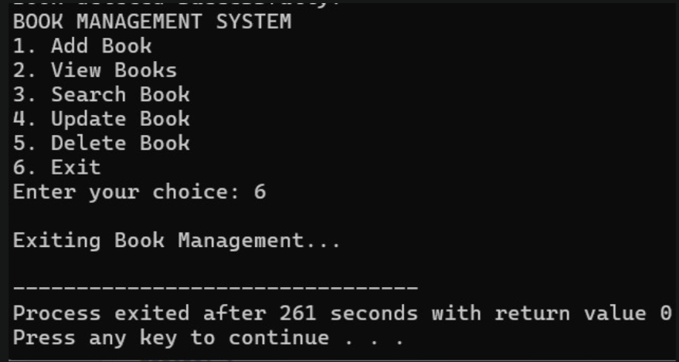
OUTPUT-05
OUTPUT-06

Slide 15
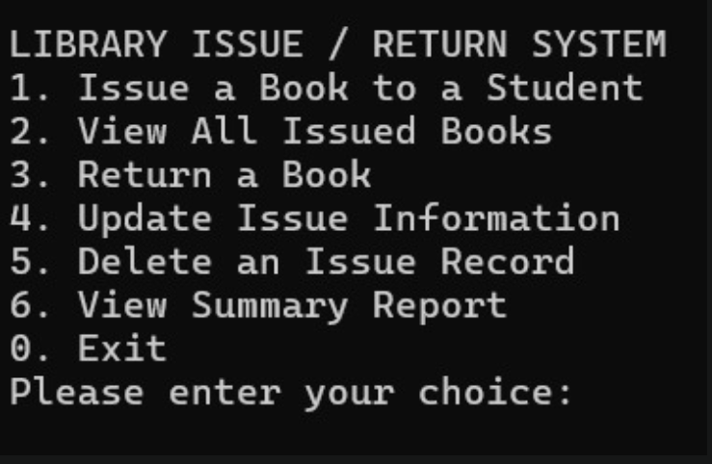
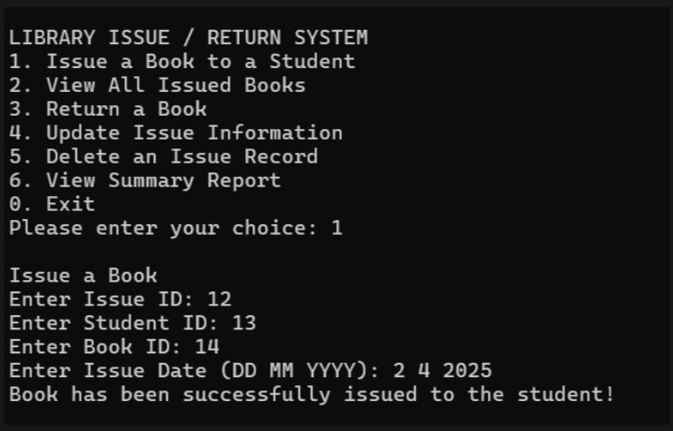
OUTPUT-07
OUTPUT-08

Slide 16
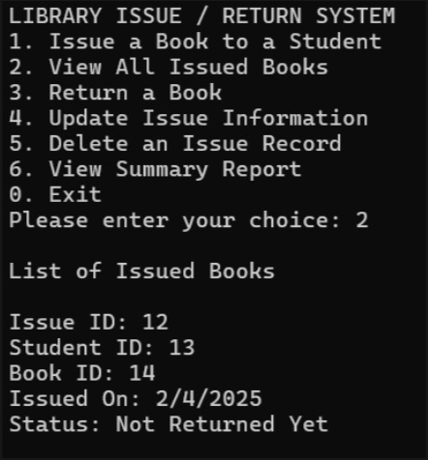
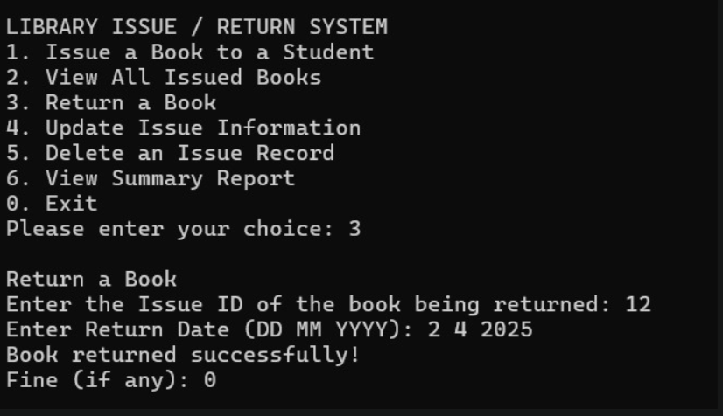
OUTPUT-09
OUTPUT-10

Slide 17
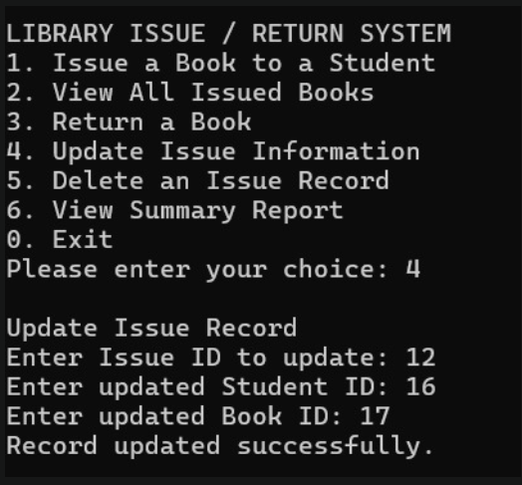
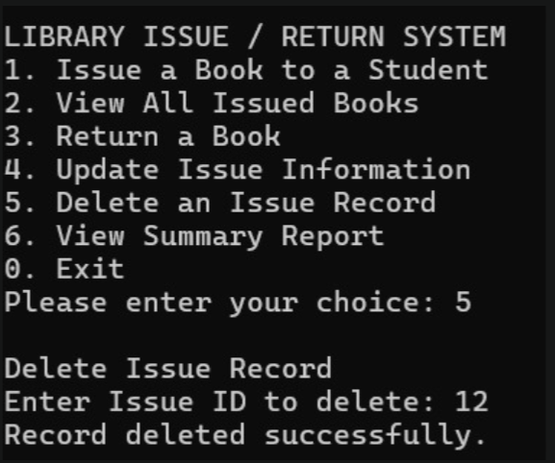
OUTPUT-11
OUTPUT-12

Slide 18
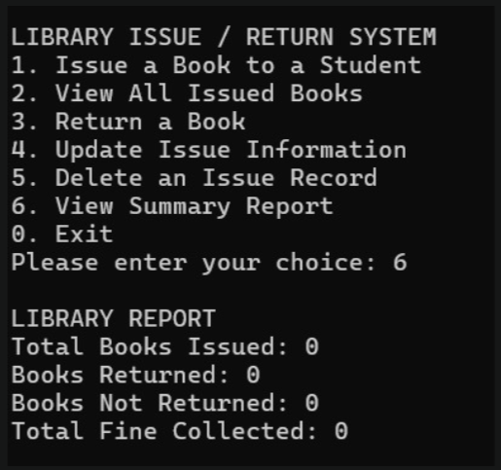
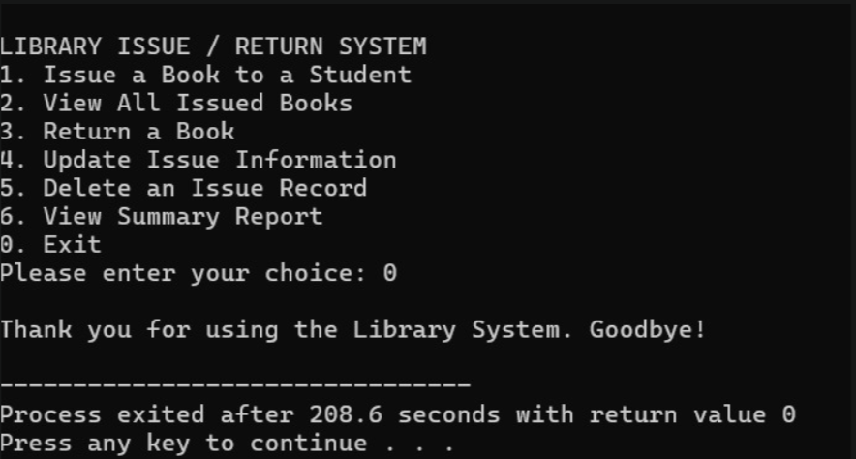
OUTPUT-13
OUTPUT-14

Slide 19
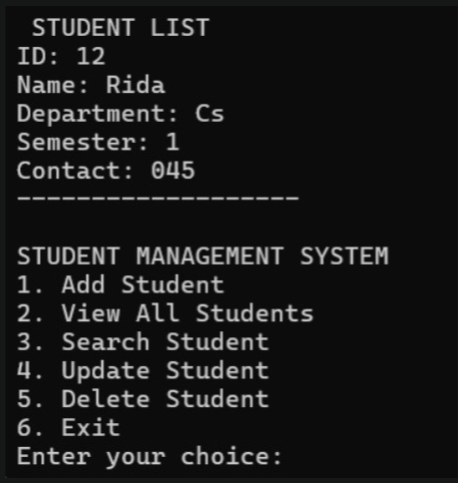
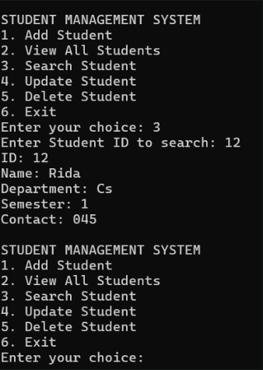
OUTPUT-15
OUTPUT-16

Slide 20
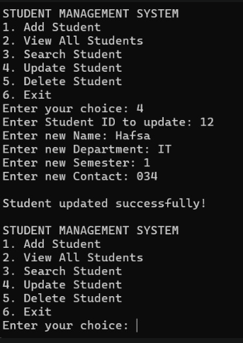
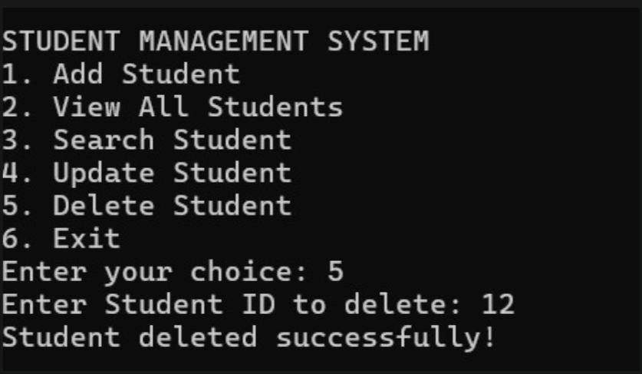
OUTPUT-17
OUTPUT-18

Slide 21
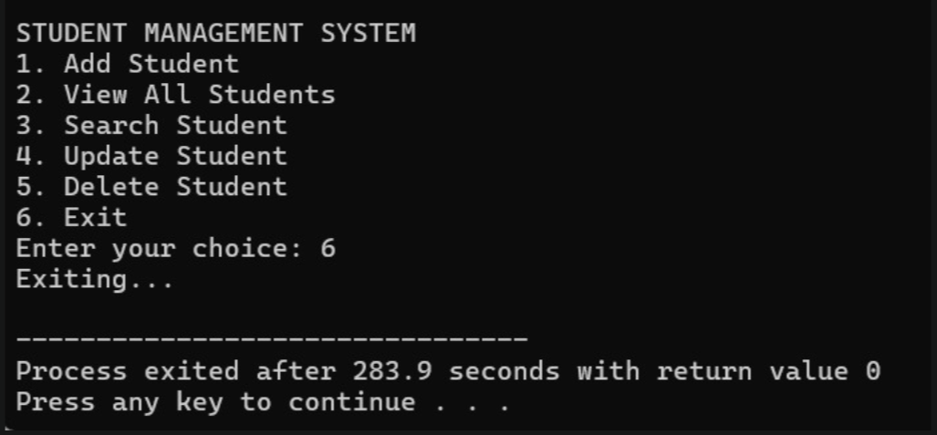
OUTPUT-19

Slide 22
THANK YOU!

